Slide 1
Electronic Boardrooms
DAOs
How to vote and allocate resources on-line
The final step in bringing all governance activity online

Slide 2
Wallet Review
Anyone can see your balance!
Anyone can see your transactions in or out!
Anyone can PUT assets in your wallet.
Only the private key holder can remove assets, sign on behalf of the wallet, enter into a smart contract tx.

Slide 3
Wallets over time
Developing a history of transactions shows the beginning of a credit score.
=> more broadly: reputation.

Slide 4
Sidenote: Bridges and Cross chain
Mainnet: Currency ETH, PoS
Typical Gas fees ~ $2-$50 / tx
Gnosis: Currency XDAI, PoA
Typical gas fees ~ $0.001 - $0.01 /tx
Polygon: Currency MATIC, PoS
Typical gas fees ~ $0.01-0.03/tx
Bridges allow you to move currency from one chain to another
NOTE: Bridges have been hacked! Use for a short time is usually ok.
Popular bridges:
ETH ⬄ Polygon: https://wallet.polygon.technology/bridge
ETH ⬄ Gnosis: https://honeyswap.org/gnosis-bridges.html

Slide 5
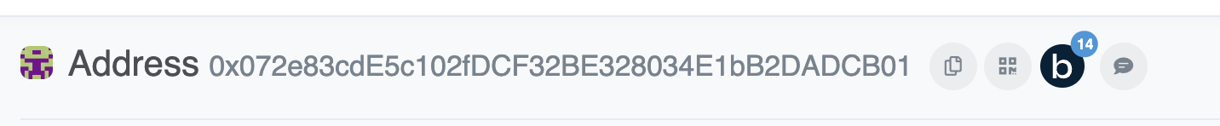
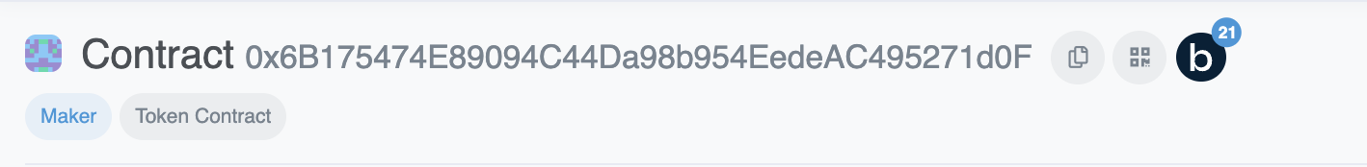
Sidenote: EVM addresses
EOA Address or Externally Owned Account, Controlled by a public/private key pair
Contract Account, controlled by their owner

Slide 6
Blockchain Benefits
Lower cost
High Security & Availability
Immutability
Decentralized

Slide 7
From one wallet to Multi-sigs
What about groups of people or wallets?
E.g. investment clubs, family investment groups.
How to organize?
Multi-signature wallets are a way of organizing on-chain.
Gnosis safe, Now Safe is the most popular with about $40B in AUM stored on-chain.

Slide 8
Safe
Investment club with 5 friends.
Pool funds on-chain, buy assets, do DeFi, etc.
Gnosis-safe.io => launch app
Easy to chose / change chains

Slide 9
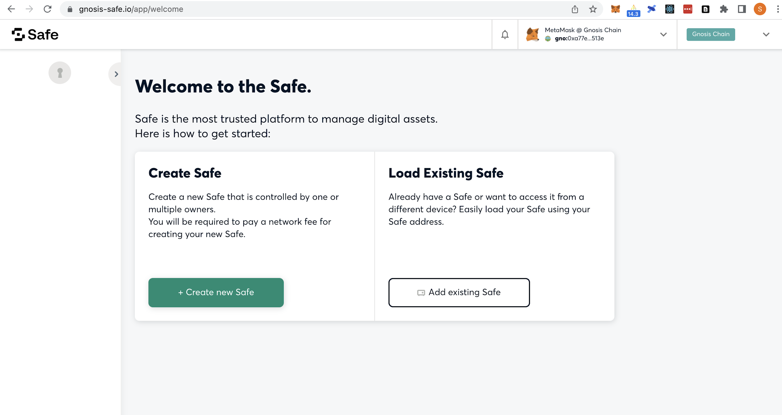

Slide 10
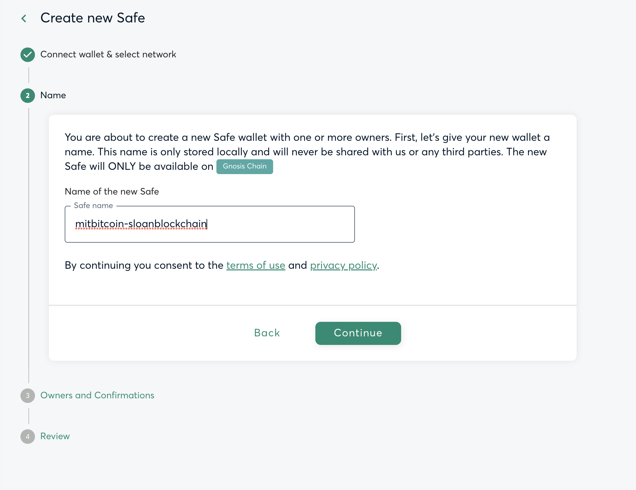

Slide 11
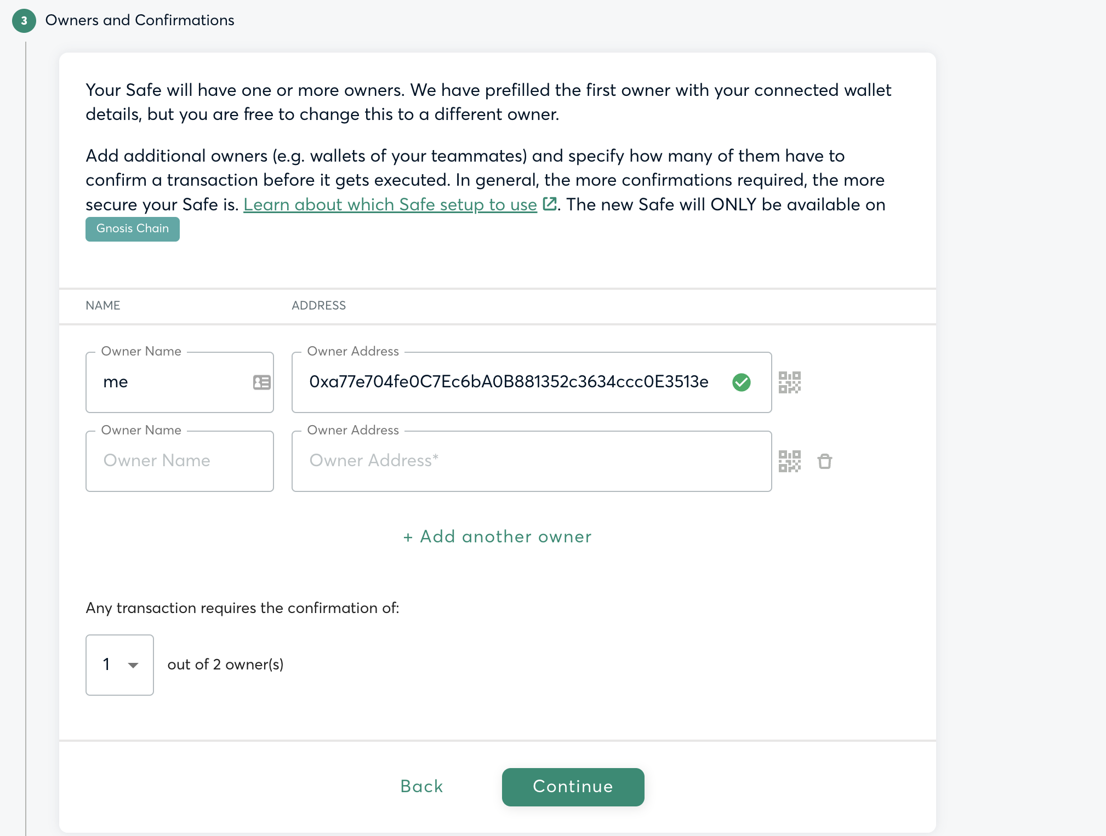

Slide 12
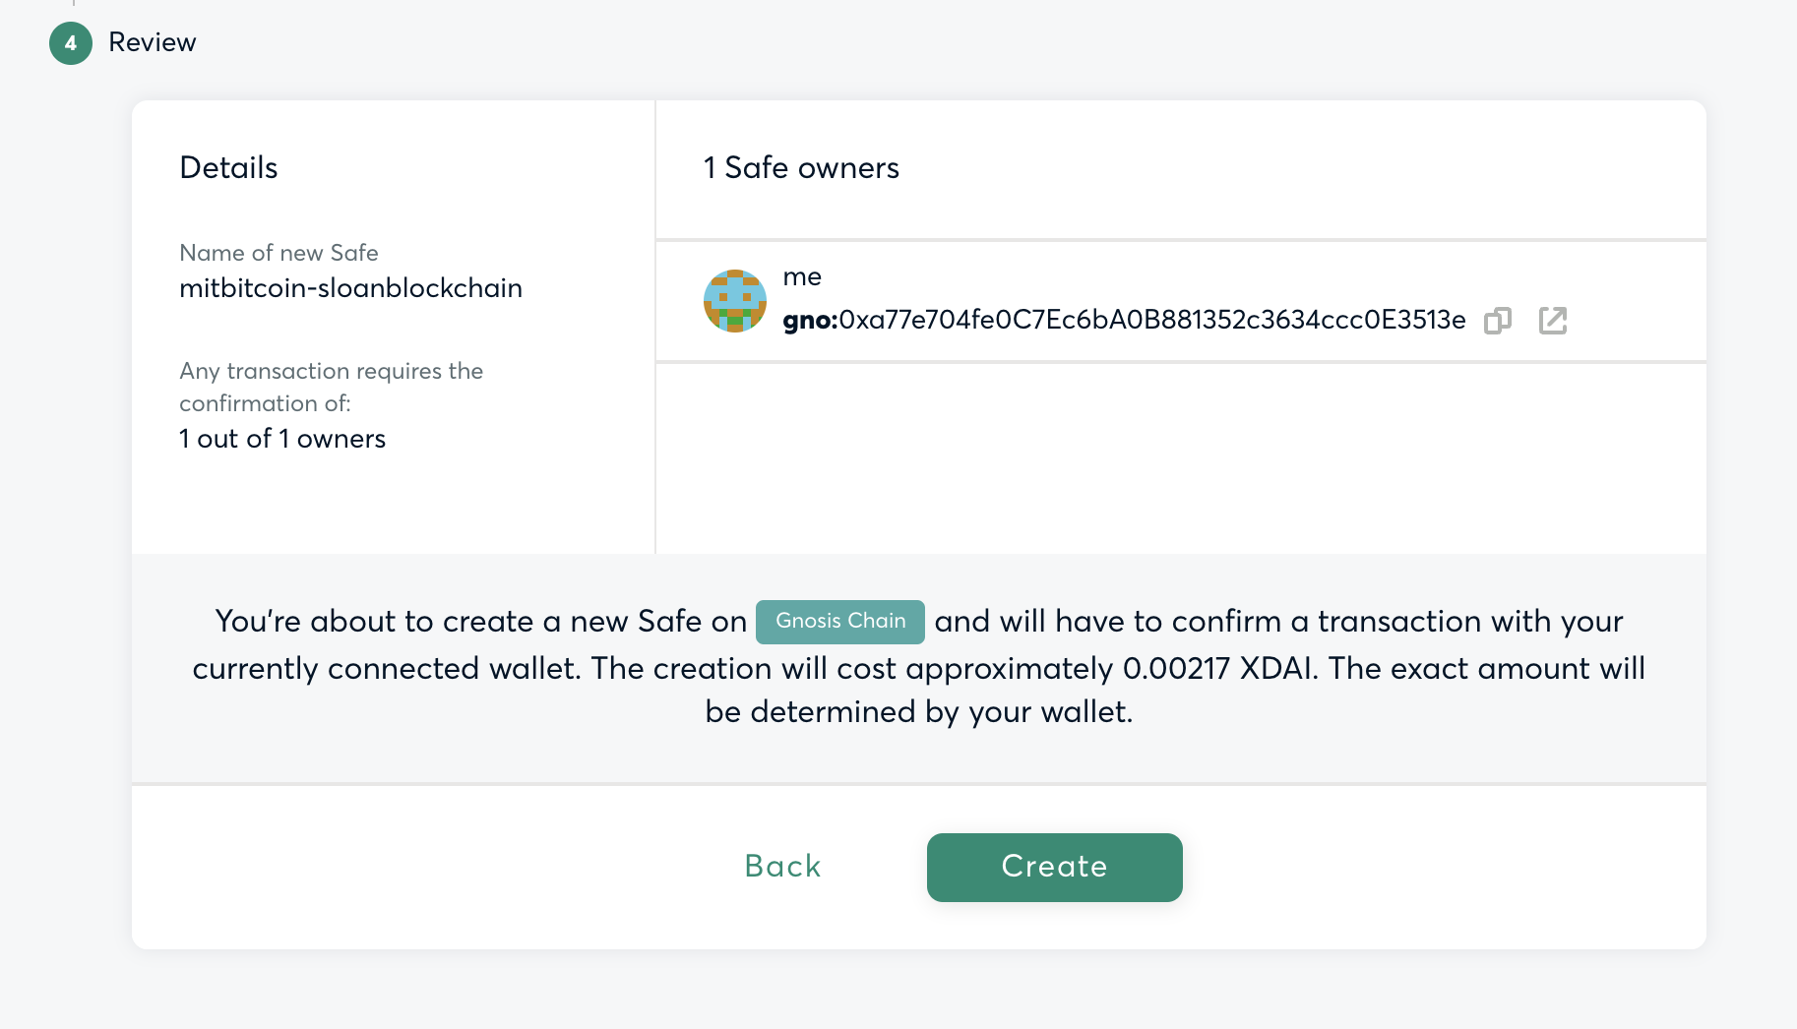

Slide 13
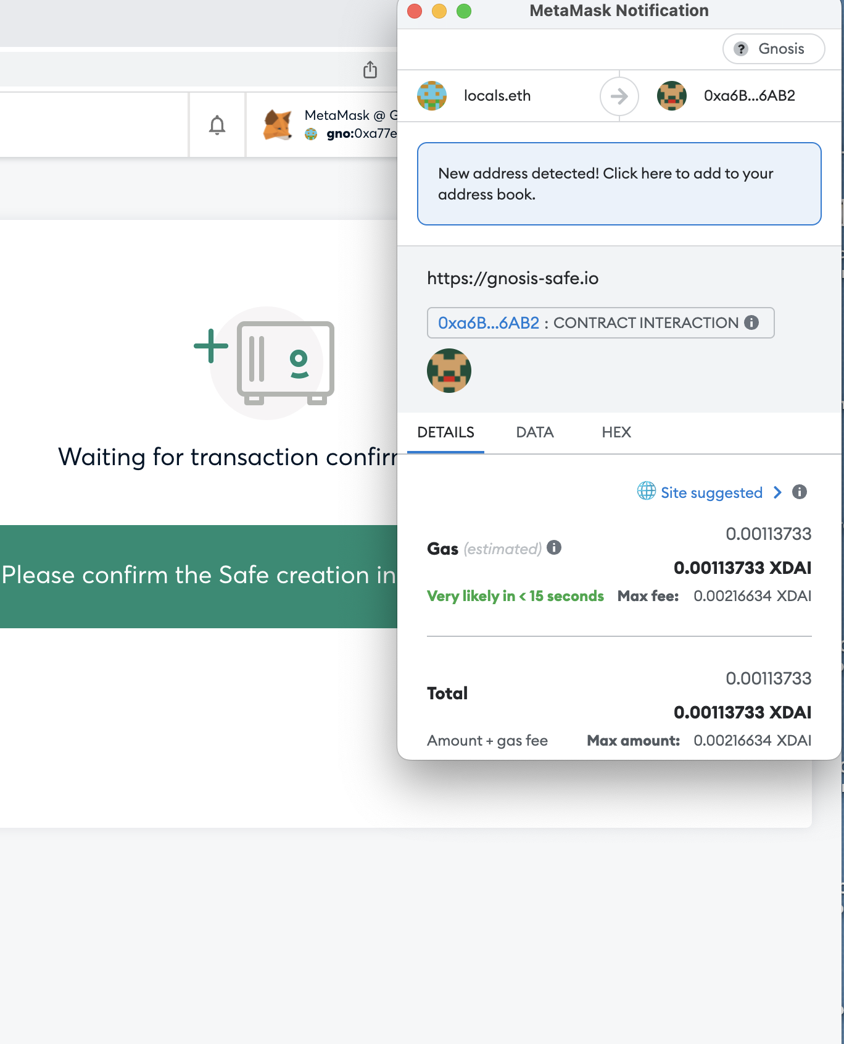

Slide 14
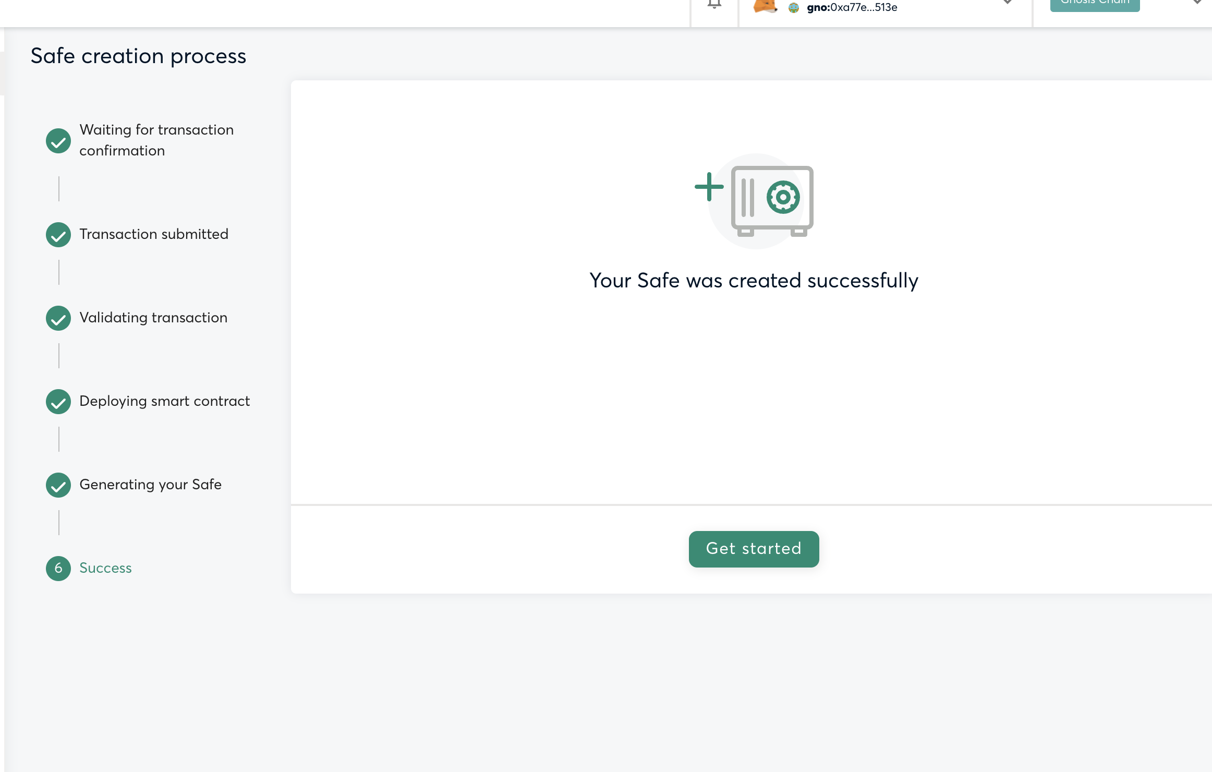

Slide 15
How does a vote get generated?
Start a transaction by one of the signers (or owners)
Automatically generates a vote which requires action
=> use betav2.hashchat.xyz to create a chat room for all signers to discuss tx and votes.

Slide 16
Other safes in use
How big can they get?

Slide 17
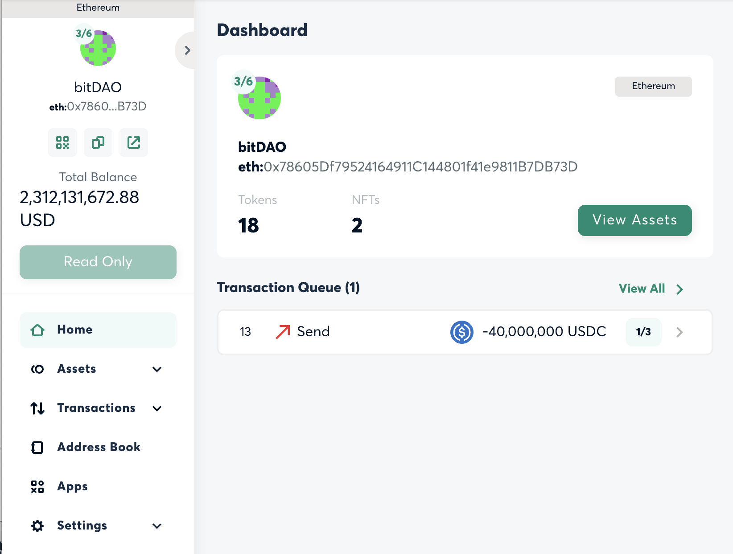
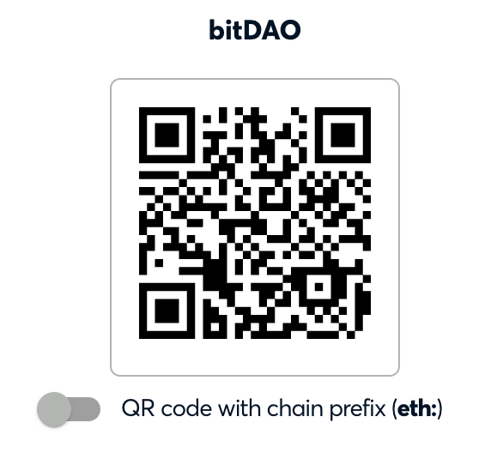
bitDAO Safe

Slide 18
Fully Web3-native Orgs
Purely online organizations can be a corporation, LLC, non-profit, foundation – virtually any type.
Purpose of an Organization?
Allocation of Resources
Time
Money
Assets

Slide 19
Example resource allocations
Voting members of the governing board
Strategic decisions
Investments (in / out)
Approve budgets
Web3: Full transparency of the ledger of financial transactions -- BY THE PUBLIC
Web3: Full transparency of each individual voting member, and how they voted -- BY THE PUBLIC

Slide 20
DAO tooling
Aragon – Anyone can create an organization and invite members
Mainnet: client.aragon.org
Colony.io
Dauhaus
Many of these use Ethereum mainnet, which has become very expensive for day-to-day operations.
Therefore all of these have an offering on xdai chain
Aragon.1hive.org
Xdai.colony.io
Dauhaus.club – native xdai

Slide 21
Setup a new org – as a team
Use aragon on Gnosis Chain (xdai)
https://aragon.1hive.org/#/
You will need the wallet for everyone on the team.
One person will create the DAO (Aragon).

Slide 22
Organizational Vote setup
Voting module has 3 parameters:
Time frame to allow people to vote (recommend 15minutes for testing, 1-10 days for real orgs)
Minimum approval – percentage of all tokens that have voted. 15% is default.
Support % 50% default -- the percent of yes votes FROM THOSE WHO HAVE VOTED. This works together with minimal approval.

Slide 23
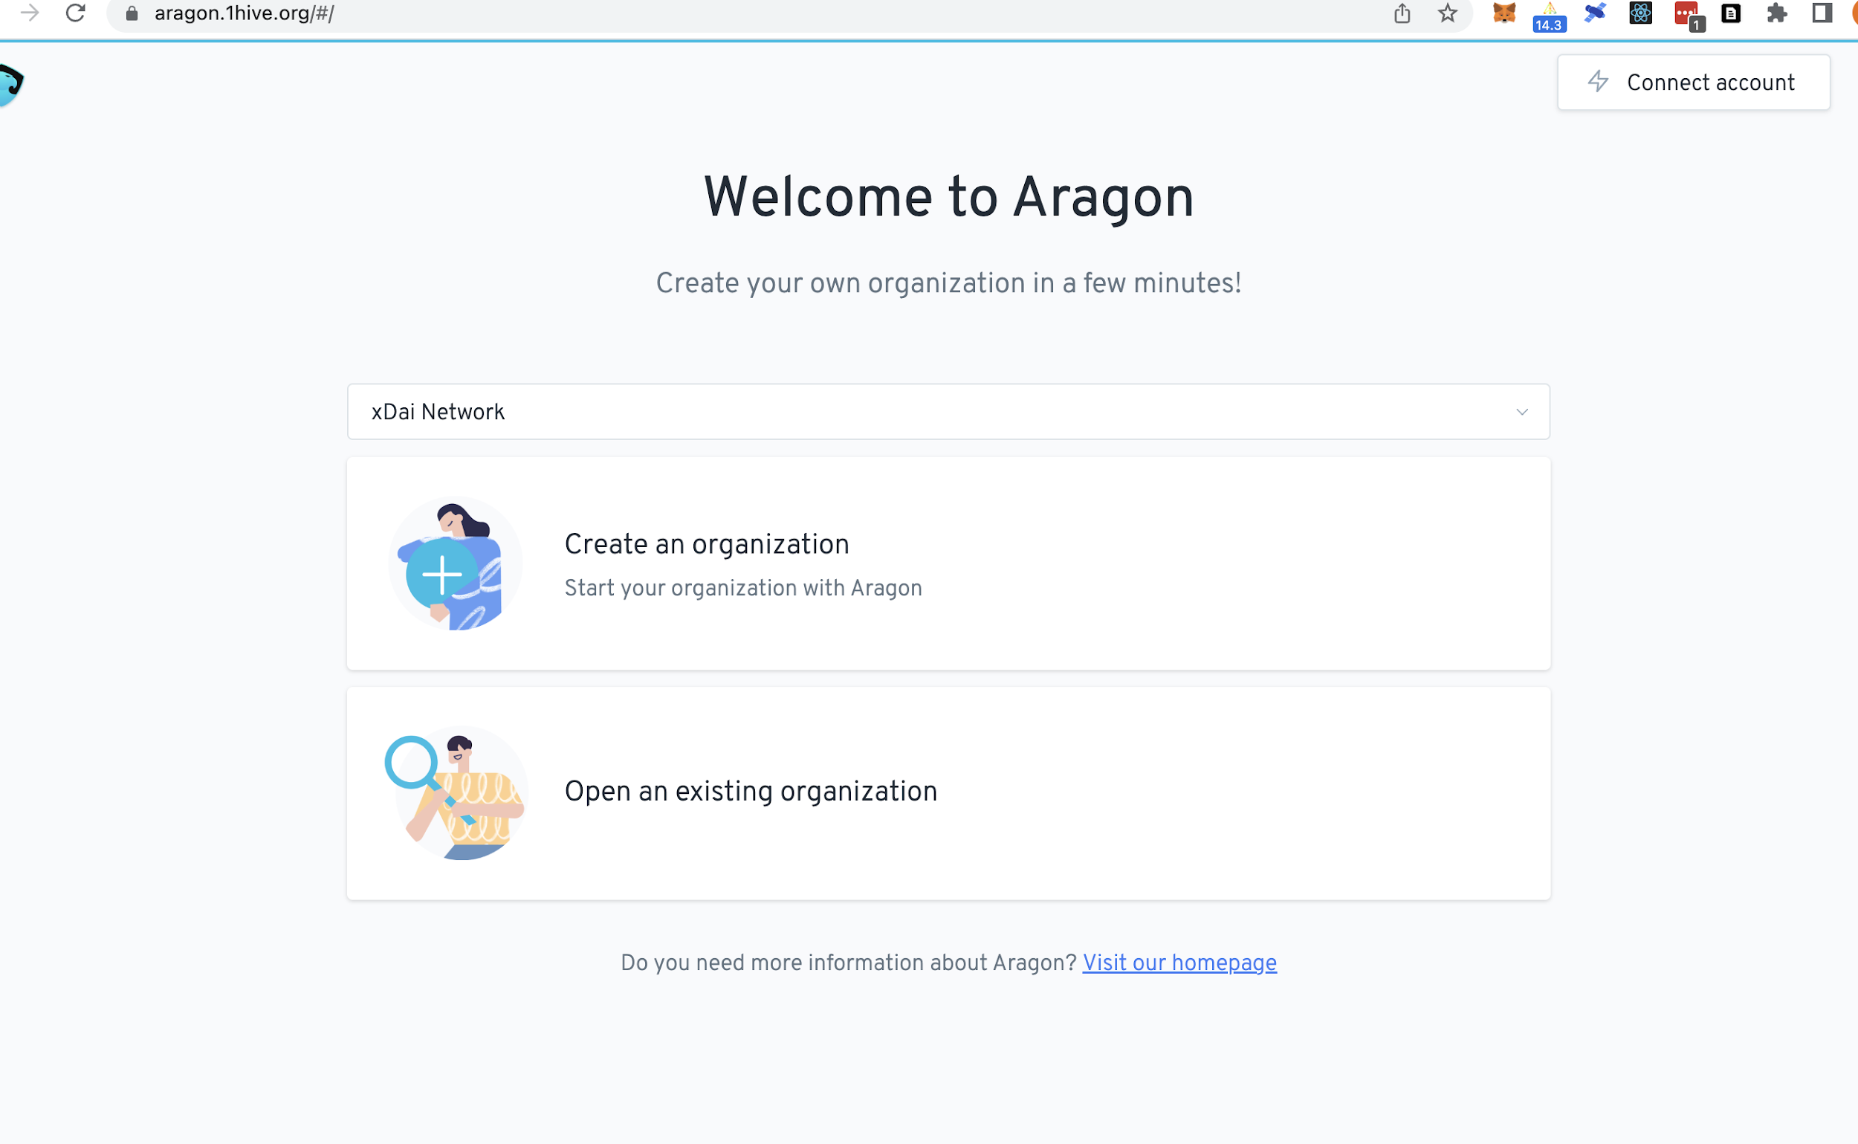

Slide 24
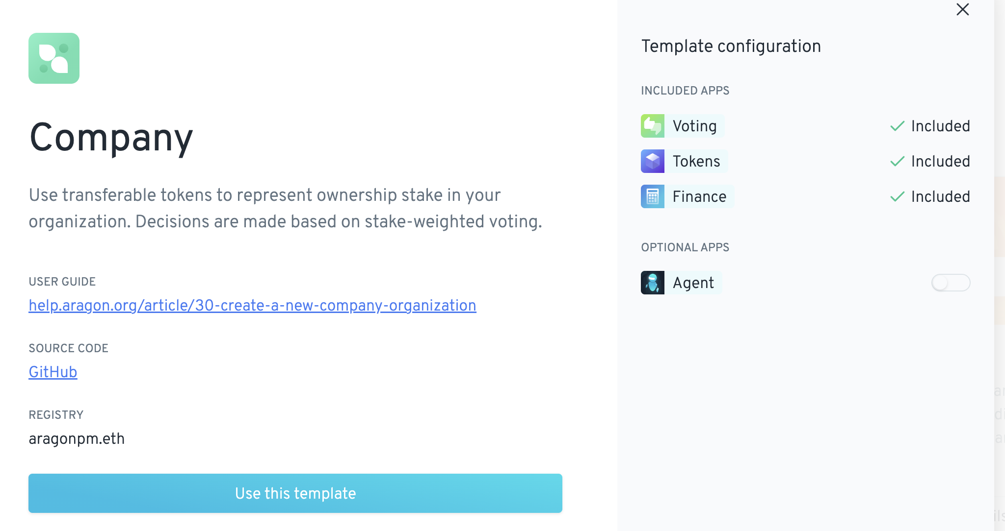

Slide 25
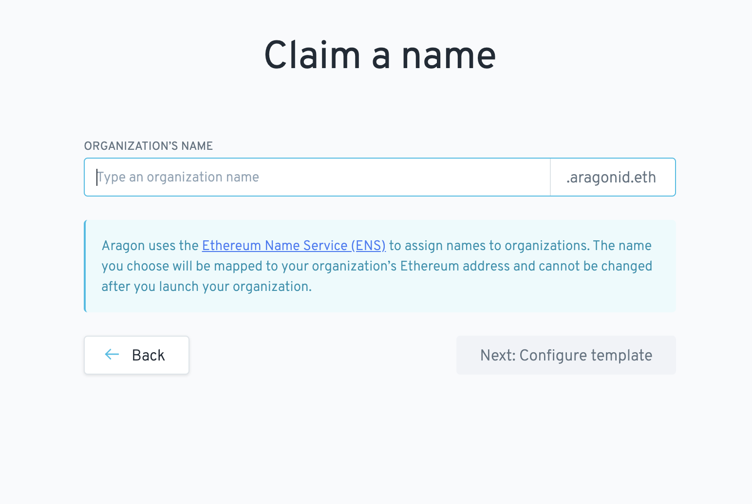

Slide 26
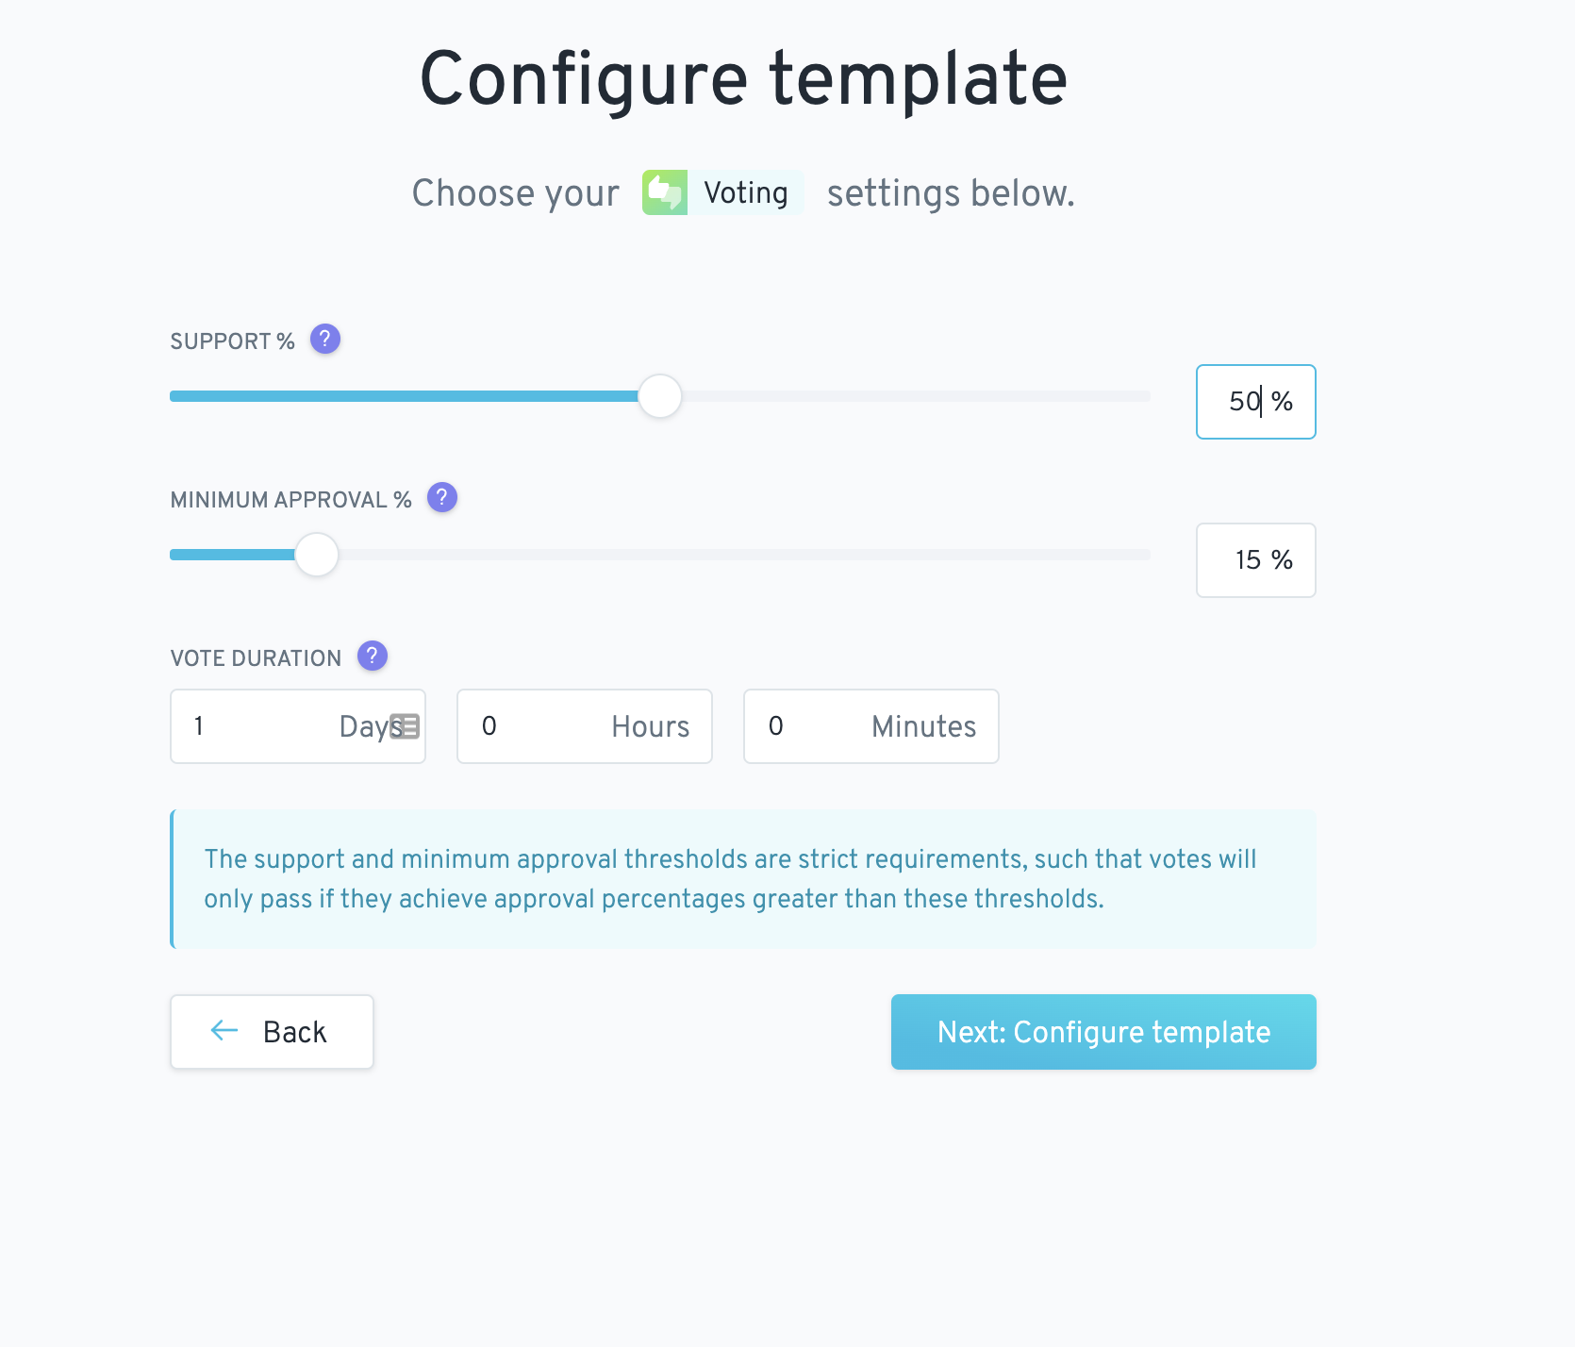

Slide 27
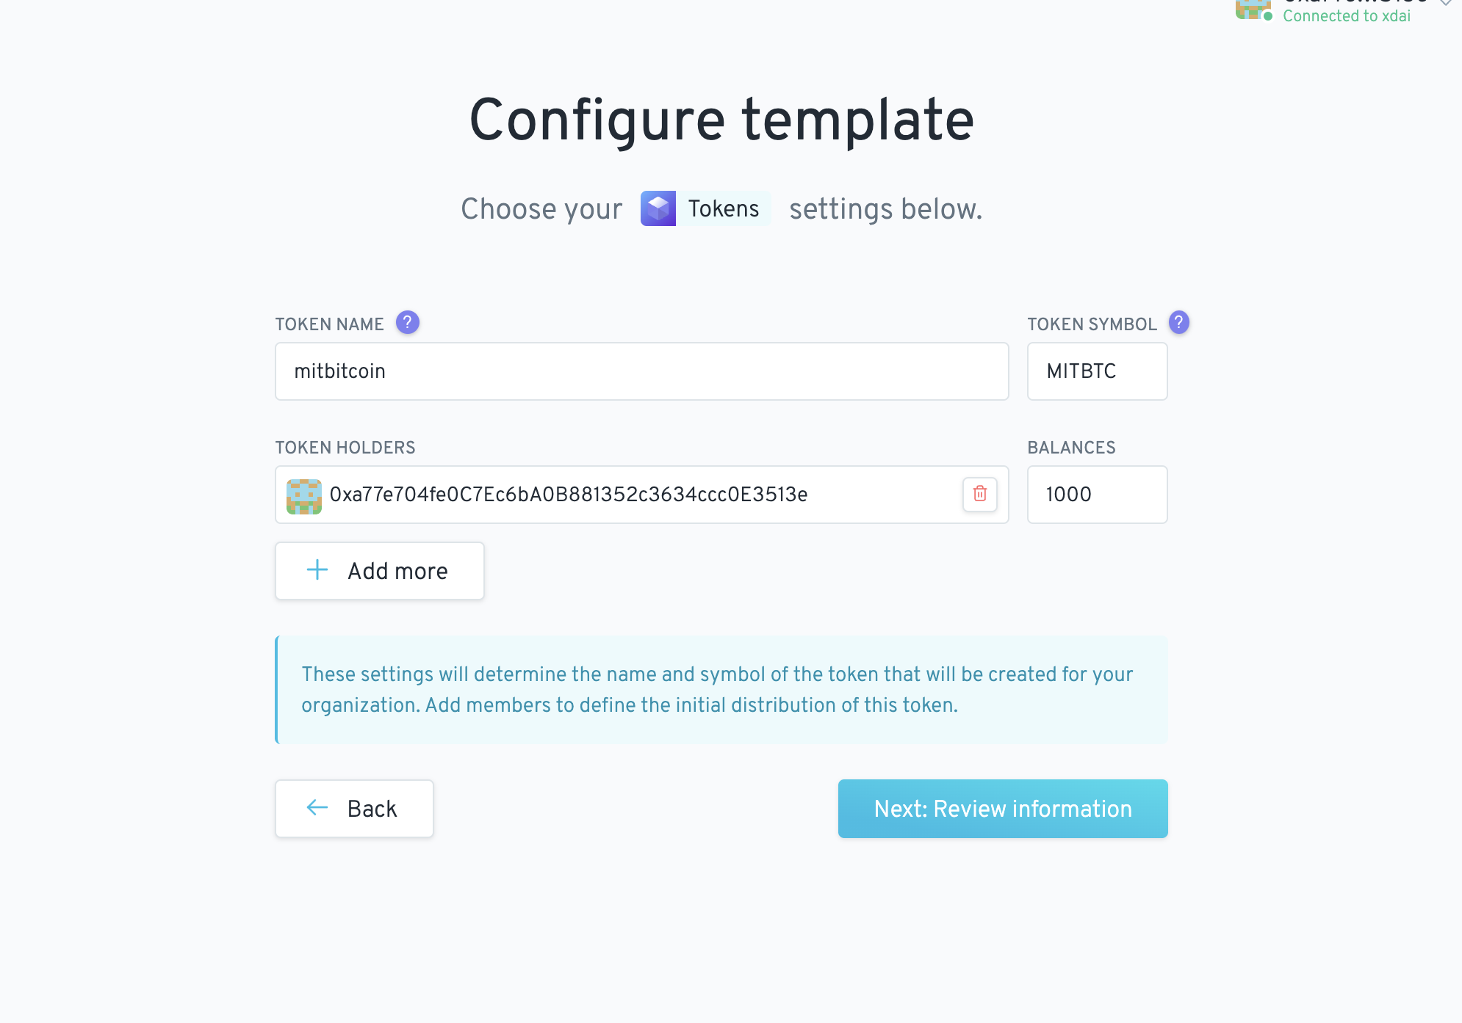

Slide 28
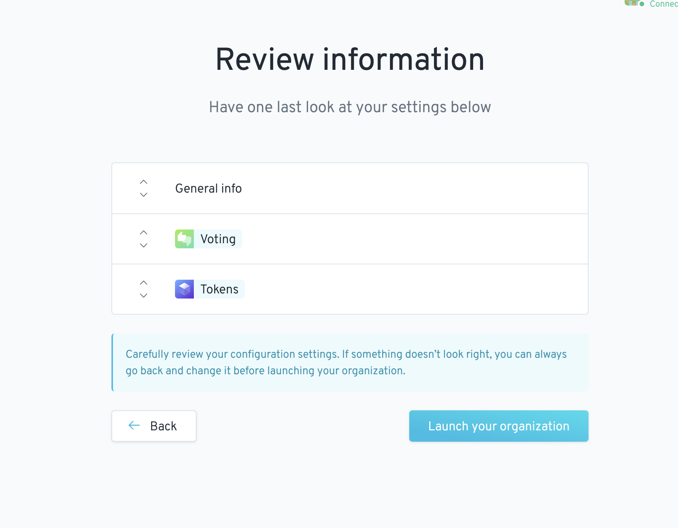

Slide 29
Voting
Generic question, up for vote.
Requires manual fulfillment
Financial transaction, started by a signer
Move tokens
Move funds out of org or trade
=> Creates a vote
Upon completion, the fulfillment of the vote (if passed) is executed.

Slide 30
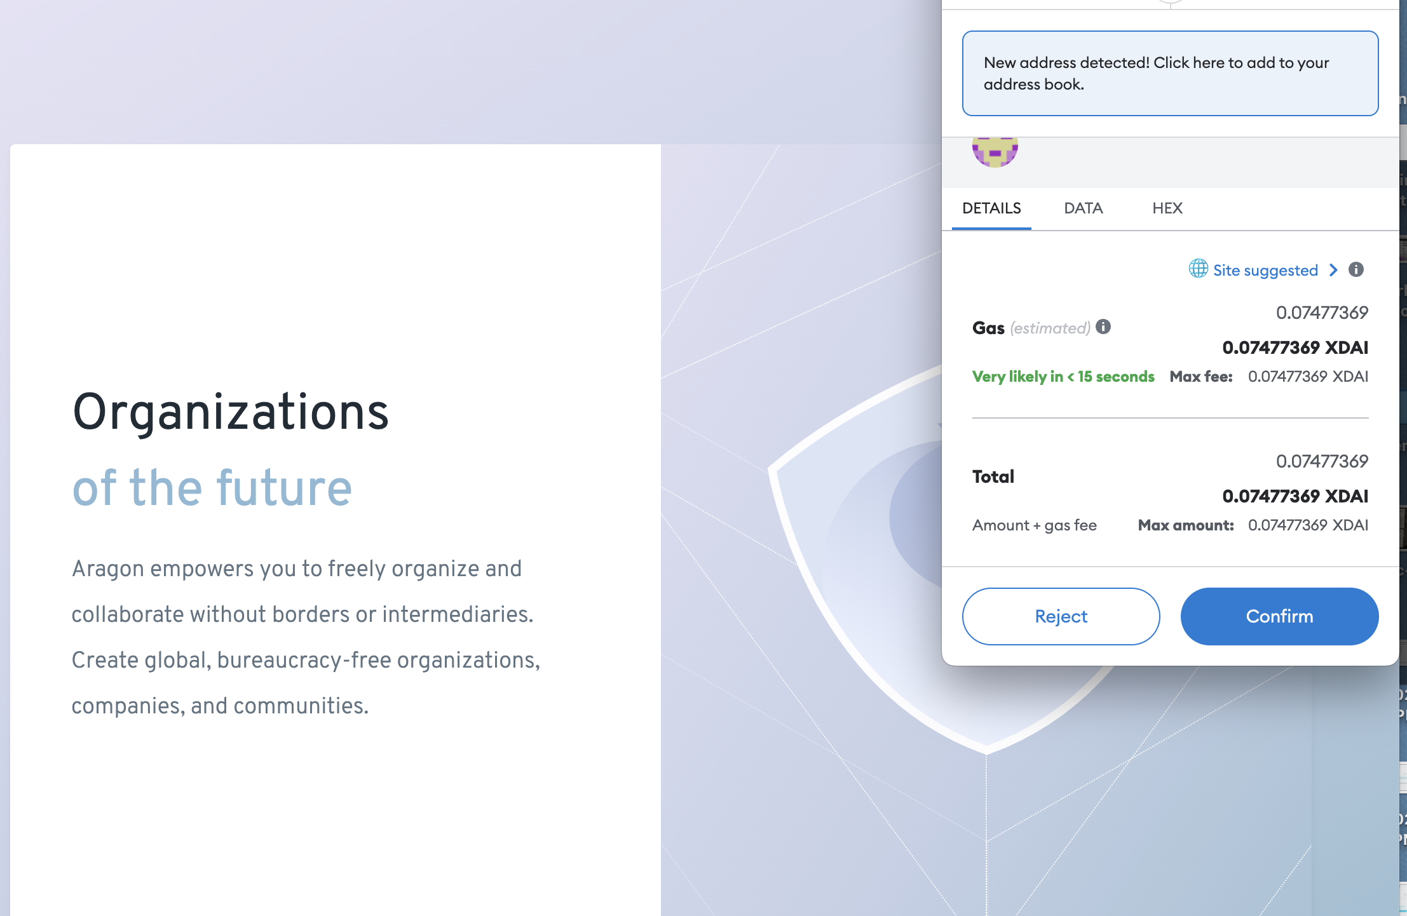

Slide 31
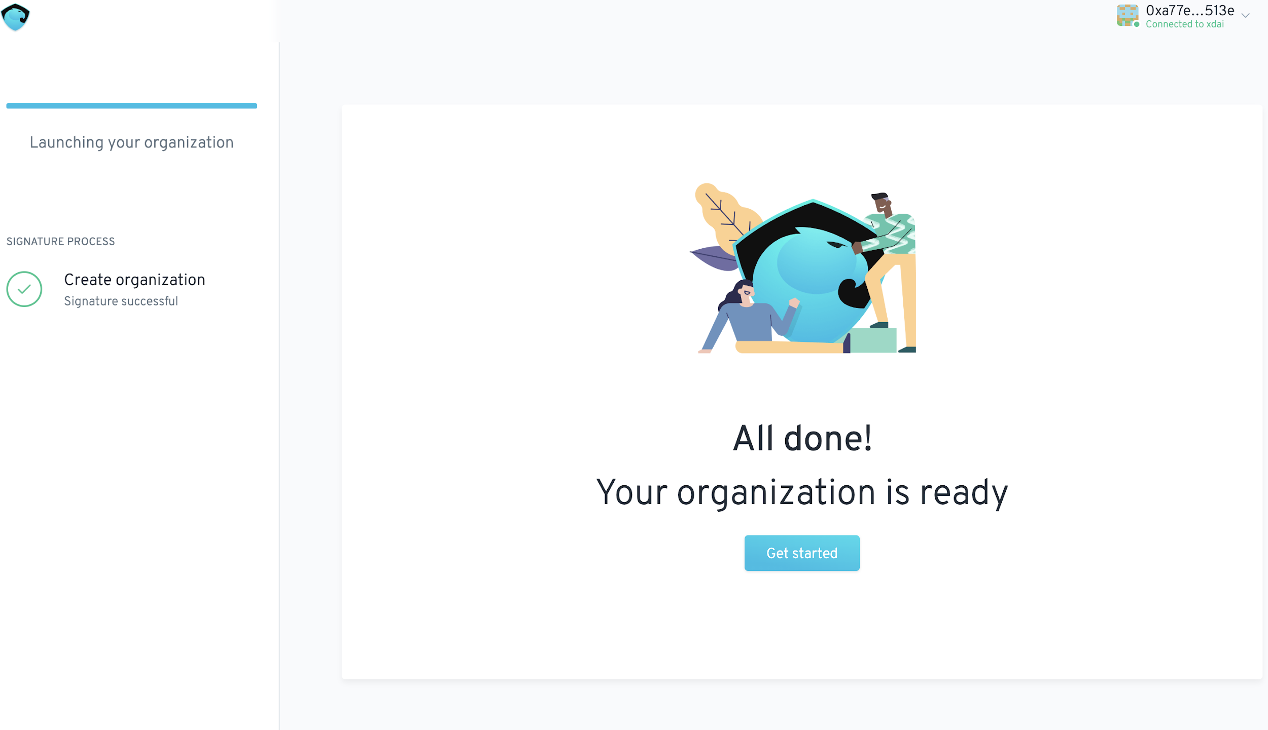

Slide 32
Blockchains are: Globally anonymous Asset rails facilitating Frictionless and trustless digital asset exchange ultimately becoming the Operating System for the Global Economy
Notes:
Globally anonymous asset rails. Frictionless and trustless value exchange powers global trade of intellectual assets.

